Slide 1

Tweet Analysis: Identifying Abusive and Hate Speech Language Text Cleansing API Building and Data Analysis
Gold Level Challange
Created by:
Hermawan

Slide 2
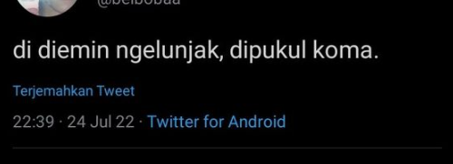
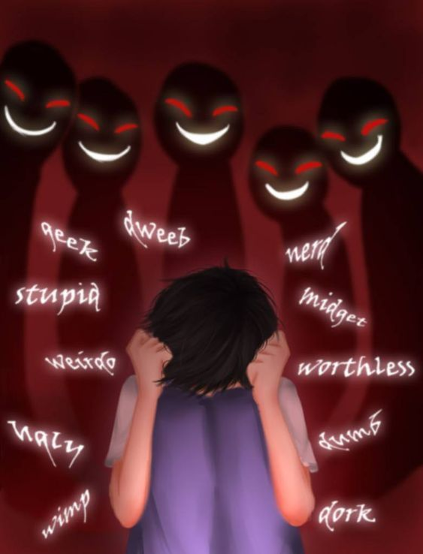
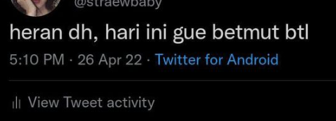
PRELIMINARY
Background
The current era of the internet allows the rapid and unfiltered spread of information, leading to the use of abusive language and hate speech to attack individuals or groups based on their race, religion, physical appearance, or sexual orientation. Such language is often found on social media and online games, especially MOBA games, where players may include school-age children or individuals with mental disorders.
As a junior data scientist in MOBA online games, I have decided to use Twitter data for descriptive analysis and pattern identification due to its vast amount of text data in the form of tweets. This analysis aims to provide evidence for the importance of text processing and cleaning abusive words in MOBA online games to create a healthy and non-toxic gaming environment. The results of the analysis will be used as a reference to develop an API that can process text, detect, and remove abusive words effectively.
Objectives
Identifying tweet with abusive and hate speech words
Analysis total words and total characters using univariate and bivariate EDA analysis
Building an API Text Processing that can clean up rude words and replace slang words with normal words.

Slide 3
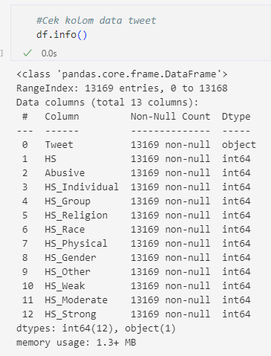
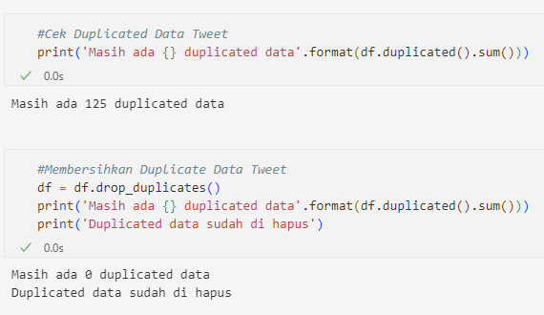
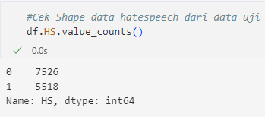
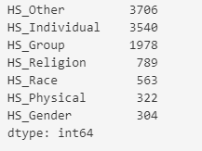
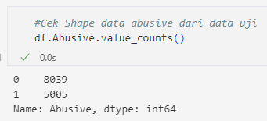
RESEARCH METHODS
DATA PREPARATION
The data used is secondary data obtained from Kaggle
The data has 13 columns and 13169 rows, with no missing values.
However, there were 125 duplicated data, so the number of data after removing duplicates was reduced to 13044 rows.
In the data, there are 5518 tweets categorized as hates peech, with the most common types being HS_Other, HS_Individual, and HS_Group. Additionally, there are also 5005 data containing the word abusive.

Slide 4
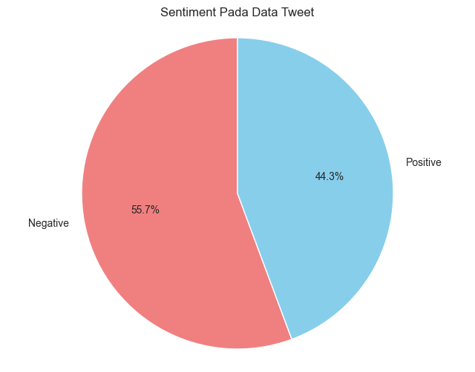
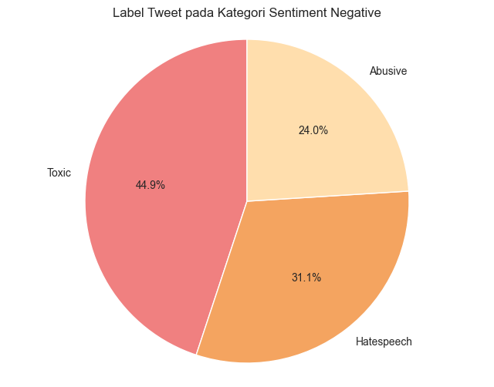


RESEARCH METHODS
EXPLORATORY DATA ANALYSIS
The most prevalent type of hate speech is related to invective/slander, followed by hate speech directed towards individuals, and finally hate speech related to gender/sexual orientation.
By looking at the HS and Abusive collumn in the dataframe, a new column is created to determine the sentiment of the tweets. If HS and Abusive do not have values, the sentiment label is Positive. If either HS or Abusive (or both) have values, the sentiment label is Negative.
From the dataset, it is found that there are more tweets with negative sentiment 7261(55,7%) than those with positive sentiment 5783(44,3%), with a difference of 11.4% of the total 13,044 data.
From 7261 negative sentiment tweets, it can be concluded that tweets containing both abusive and hate speech words (Toxic) are 3262 (44.9%), while tweets containing only hate speech are 2256 (31.1%), and tweets containing only abusive words are 1743 (24.0%).

Slide 5
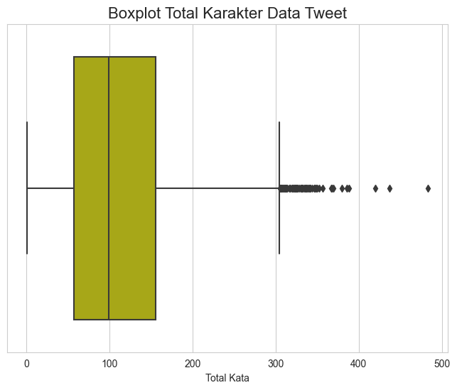
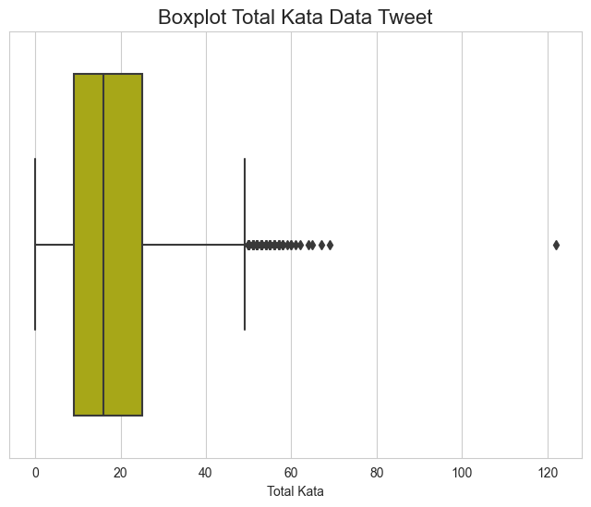
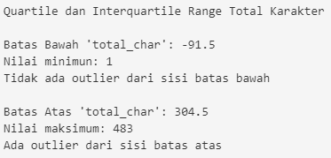
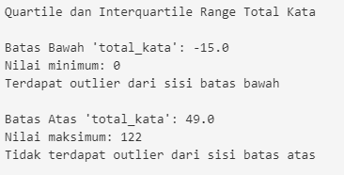
RESEARCH METHODS
EXPLORATORY DATA ANALYSIS
The most prevalent type of hate speech is related to invective/slander, followed by hate speech directed towards individuals, and finally hate speech related to gender/sexual orientation.
The total number of characters has a quartile and interquartile range. The lower boundary of 'total_char' is -91.5, with a minimum value of 1, and no outliers on the lower side. On the other hand, the upper boundary of 'total_char' is 304.5, with a maximum value of 483, and outliers exist on the upper side.
The Interquartile Range for total words is 49, with a minimum value of 0 and a maximum value of 122. However, there are outliers on the lower end with a lower boundary of -15, while no outliers were found on the upper end

Slide 6
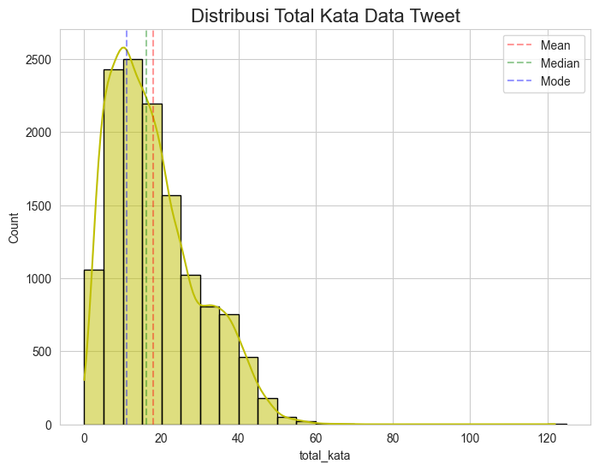
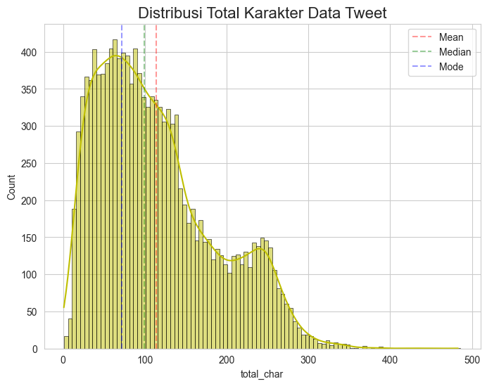
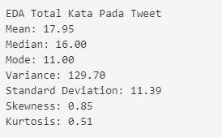
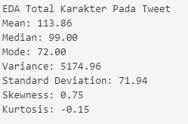
RESEARCH METHODS
EXPLORATORY DATA ANALYSIS

Slide 7
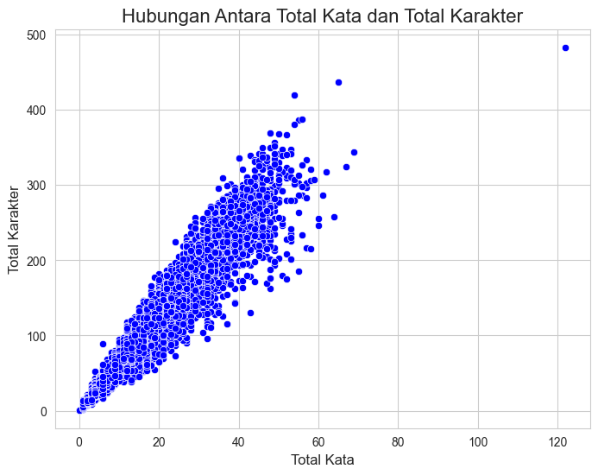
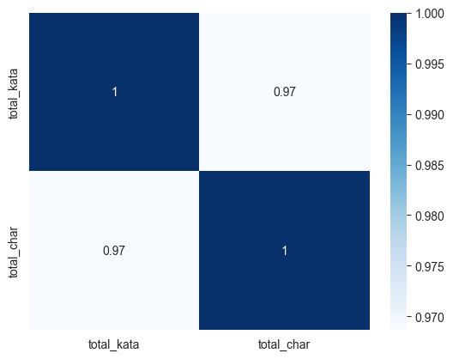
RESEARCH METHODS
EXPLORATORY DATA ANALYSIS
there was a strong positive linear correlation between total_kata and total_char, with a correlation coefficient of 0.97

Slide 8



RESEARCH METHODS
TEXT NORMALIZATION
Text Processing
Text cleansing using RegEx library
Remove Abusive words with help of abusive.csv
Replace non standard words with the help of kamusalay.csv
Original Data
Data.csv
Clean Data
TWEET COMPARISON

Slide 9
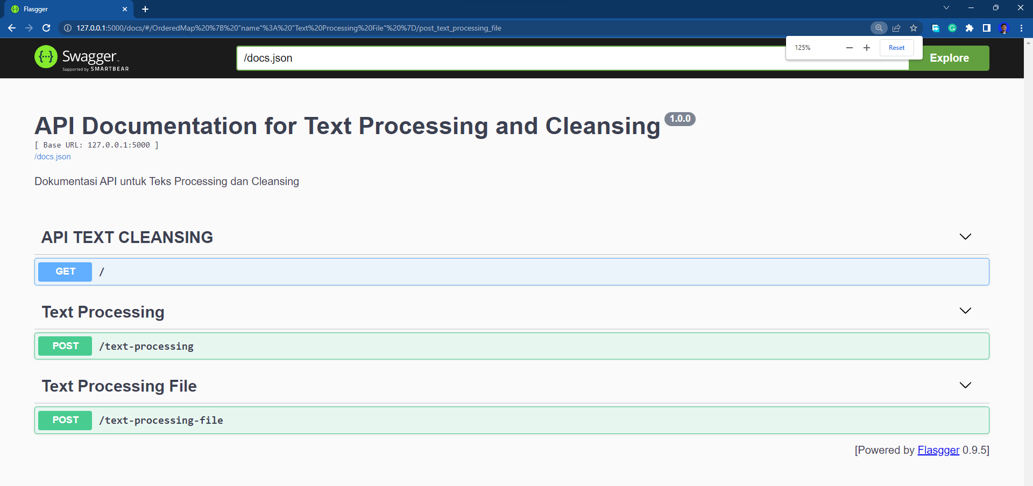
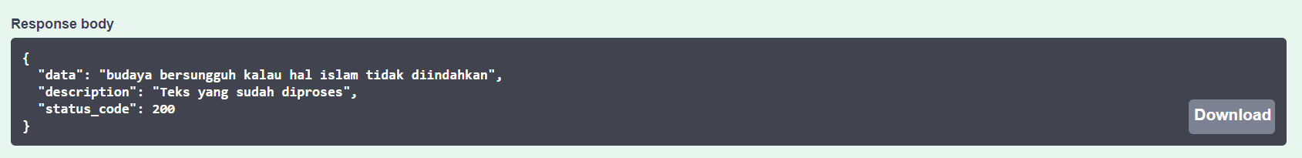
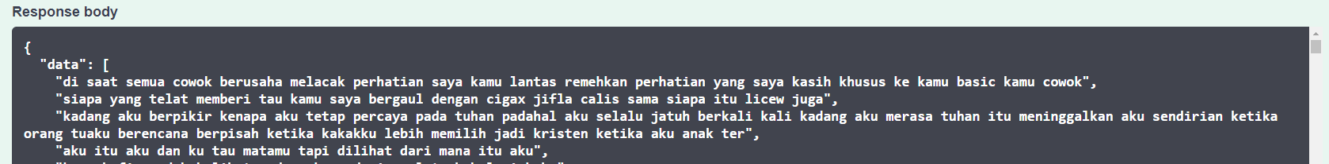
RESEARCH RESULT
API PROCESSING TEXT CLEANSING

Slide 10
RESEARCH RESULT
RESULT
The descriptive analysis reveals that 56.7% of the tweets in the dataset have negative sentiment, which is higher than the 44.3% of tweets with positive sentiment. This implies a significant difference of 11.4% in the total of 13,044 data. Further analysis on the negative sentiment tweets shows that 44.9% of them contain both abusive and hate speech words (Toxic), while 31.1% contain only hate speech and 24.0% contain only abusive words.
In conducting exploratory data analysis (EDA) using univariate and bivariate analysis, the dataset was analyzed for two variables: total_char (total characters) and total_kata (total words). The mean value for total_char was 113.86 with a median of 99 and a mode of 72. The range for total_char was 482, and there were no outliers on the lower end of the quartile and interquartile range. However, there were outliers on the upper end, with a maximum value of 483. The variance for total_char was 5175.35, which was greater than the mean, while the standard deviation was 71.94, which was smaller than the mean. The skewness for total_char was 0.75, which indicated a positive skew, and the kurtosis was -0.15, indicating a platykurtic distribution.
For total_kata, the mean was 17.95, the median was 16, and the mode was 11. The range for total_kata was 122, and there were outliers on the lower end of the quartile and interquartile range. However, there were no outliers on the upper end. The variance for total_kata was 129.71, which was greater than the mean, while the standard deviation was 11.39, which was smaller than the mean. The skewness for total_kata was 0.85, which indicated a positive skew, and the kurtosis was 0.51, indicating a platykurtic distribution.
Furthermore, there was a strong positive linear correlation between total_kata and total_char, with a correlation coefficient of 0.97.
The API created has 2 endpoints for each model (to process text and file data) and can clean up punctuation, rude words and replace slang words with normal words.

Slide 11
RESEARCH RESULT
CONCLUTION AND RECOMMENDATION
The analysis of Twitter data with analisys descriptive has revealed a high prevalence of negative sentiment and abusive/hate speech in online communication. This highlights the need for effective text processing and filtering tools to create a healthy and non-toxic gaming environment.
The EDA analysis with bivariate and univariate showed that the length of tweets varies widely, with most tweets containing around 100 characters and 16 words. However, there are also outliers with very long tweets. Additionally, there was a strong positive correlation between total_char and total_kata, indicating that longer tweets also tend to have more words.
Finally, the developed API provides a useful tool for processing text data, detecting and removing abusive language, and replacing slang words with standard words, which can be implemented in MOBA online games to improve the quality of communication and reduce toxicity.

Slide 12



THANK YOU
CONTACTS :
Hermawan
GitHub Repository

